Slide 1

Skills for Success with Microsoft Office 2016 Volume 1
by Margo Chaney Adkins, Catherine Hain, Lisa Hawkins, and Stephanie Murre Wolf
Access Chapter 4
Create Reports
Notes:
Skills for Success with Microsoft Office 2016 Volume 1

Slide 2
Skills
Build Queries for Reports
Create Reports Using the Report Tool
Format Reports
Add Totals to Reports
Preview and Print Reports
Notes:
The skills of this chapter are:
Build Queries for Reports
Create Reports Using the Report Tool
Format Reports
Add Totals to Reports
Preview and Print Reports
The skills continue on the next slide.

Slide 3
Skills (cont.)
6. Create Reports with the Blank Report Tool
7. Group and Sort Reports
Modify Report Layouts
Filter Reports
Create Label Reports
Notes:
Additional skills include:
Create Reports with the Blank Report Tool
Group and Sort Reports
Modify Report Layouts
Filter Reports
Create Label Reports

Slide 4
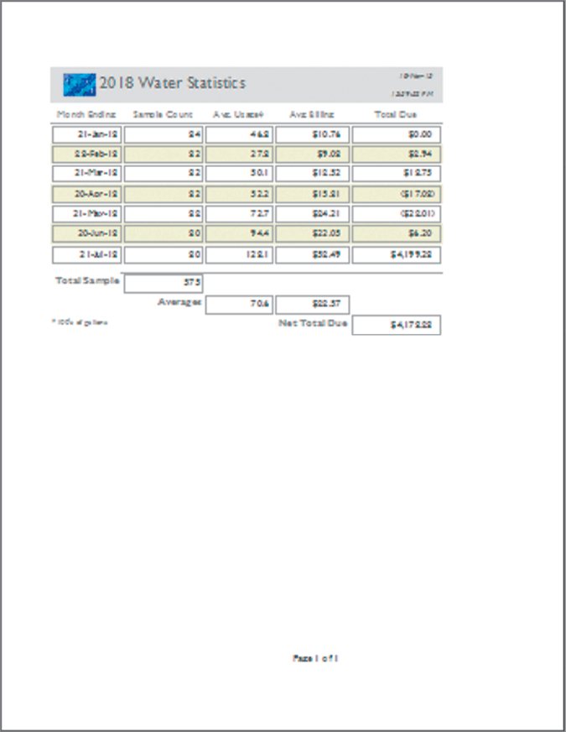

Outcome
Notes:
Using the skills in this chapter, you will create an Access report like this.

Slide 5
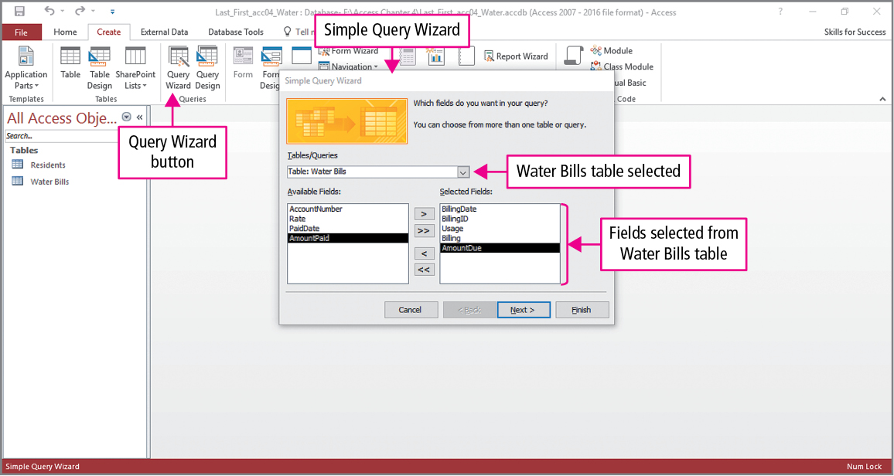
Skill 1: Build Queries for Reports
Notes:
Reports are often based on queries. Needed fields and criteria are added to the query, and then the report is created using the query as the data source. To create a new query, click the Query Wizard in the Queries group on the Create tab to open the New Query dialog box. Select the Simple Query Wizard to open the Simple Query Wizard from which table and fields are selected.

Slide 6
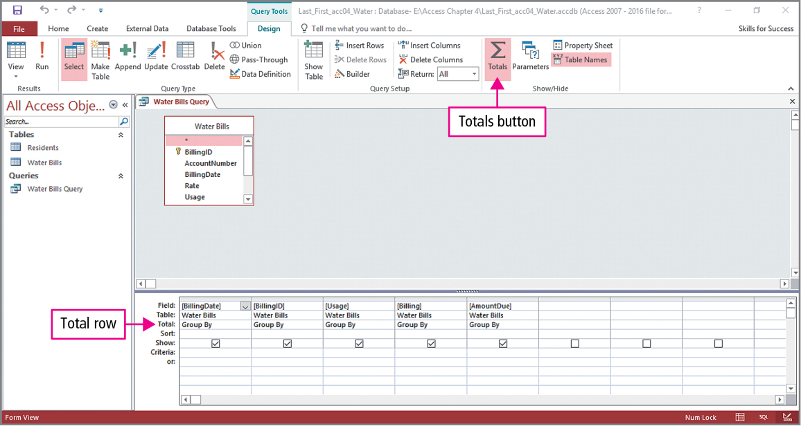
Skill 1: Build Queries for Reports (cont.)
Notes:
Switch to Design view, and click Totals in the Show/Hide group on the Home tab to create a Total row in the query design grid.

Slide 7
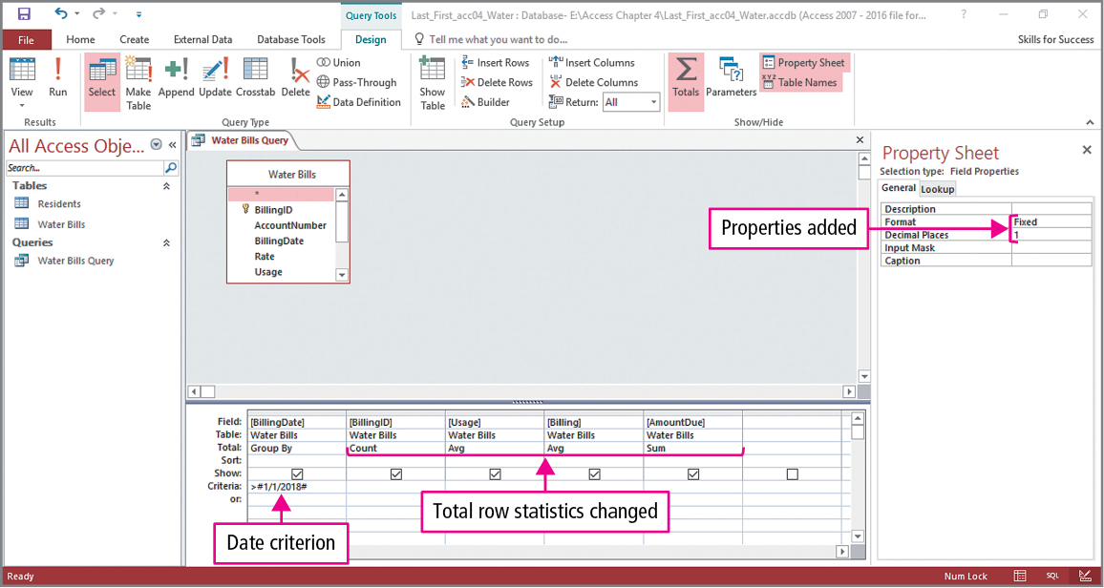
Skill 1: Build Queries for Reports (cont.)
Notes:
Click the Total row cell in the BillingID column to display the arrow and select Count. This technique is used to place Averages in two columns and Sum in the last, and >1/1/2018 is typed in the BillingDate Criteria row. Finally, the Usage column is selected, and using the Property Sheet button in the Show/Hide group, the format is set to Fixed and the number of decimal places is set to 1.

Slide 8
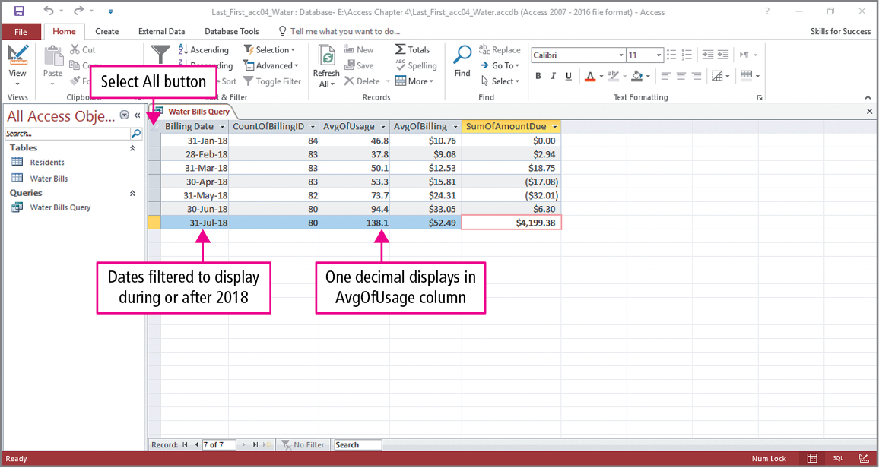
Skill 1: Build Queries for Reports (cont.)
Notes:
To improve the look of the query, the Select All button is used to apply Best Fit to all the columns. The query displays statistics about water usage and bills for each month in 2018.

Slide 9
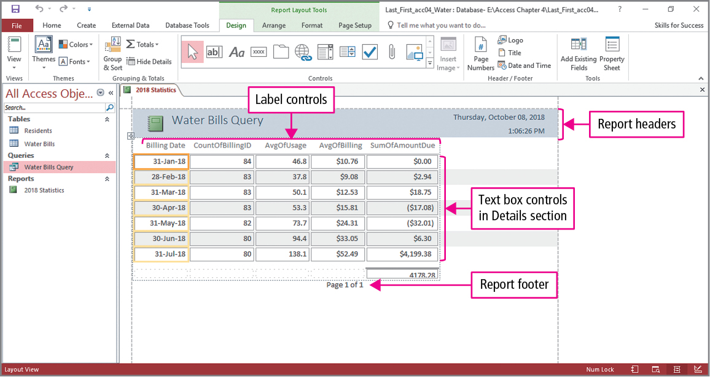
Skill 2: Create Reports Using the Report Tool
Notes:
Another way to create a report is to select a table or query in the Navigation Pane and click the Report button. Select the query or table, click Report in the Reports group on the Create tab, and a tabular report is created and displayed in Layout view. Reports have three main sections—headers, details, and footers. Each section can contain text boxes to display the Data and Label controls to identify the text boxes.

Slide 10
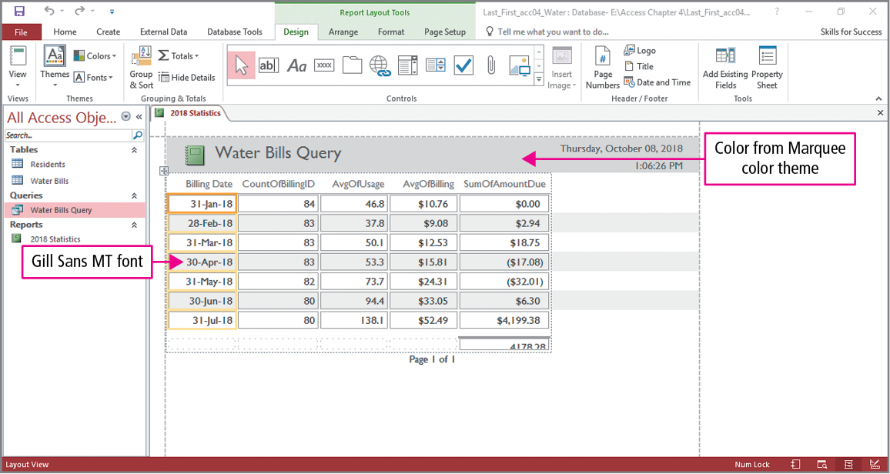
Skill 2: Create Reports Using the Report Tool (cont.)
Notes:
The report will be customized by applying a theme and changing the colors and font. To apply a theme, click Themes in the Themes group on the Design tab to display the Themes gallery from which a selection is made. To change colors, click Colors in the Themes group on the Design tab to display the Colors gallery from which a selection is made. To change the font, click Fonts in the Themes group on the Design tab to display the Fonts gallery from which a selection is made. The example on the slide used the Wisp theme, the Marquee colors, and the Gill Sans MT font.

Slide 11
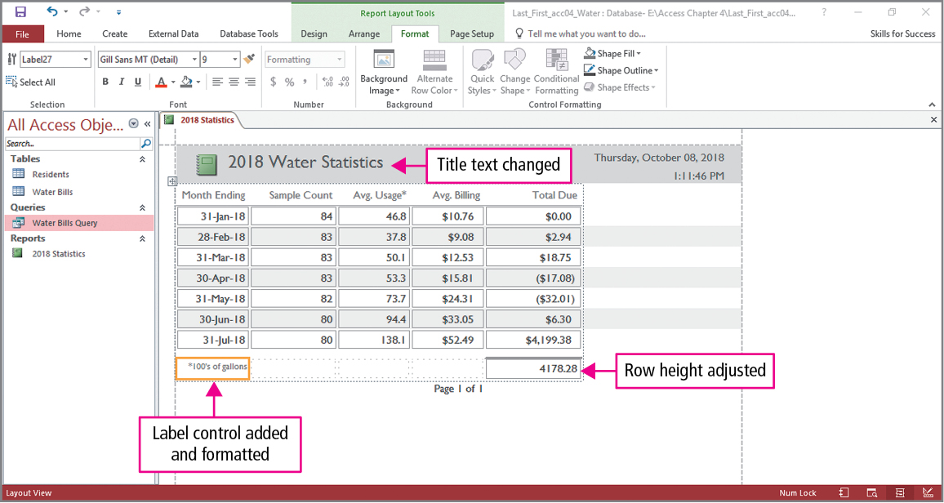
Skill 2: Create Reports Using the Report Tool (cont.)
Notes:
To change the title in the report header, double-click the existing title and change its text. This same technique can be applied to label controls. To resize a text box control, click to select it, place the pointer over the top or bottom of its orange border, and double-click to AutoSize its height. Text can be added and formatted to any empty cell. In the example on the slide, the title and column headings have been changed, the row height of the indicated cell has been adjusted, and a new label control has been added, text entered into it, and then formatted.

Slide 12
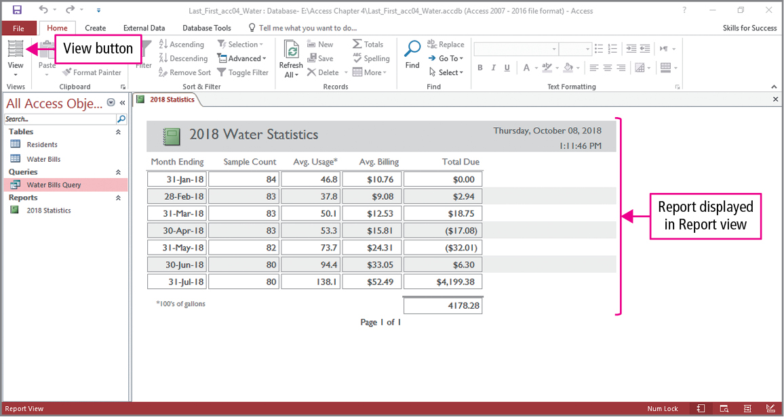
Skill 2: Create Reports Using the Report Tool (cont.)
Notes:
The view is changed to Report view, which is optimized for viewing reports on the screen.

Slide 13
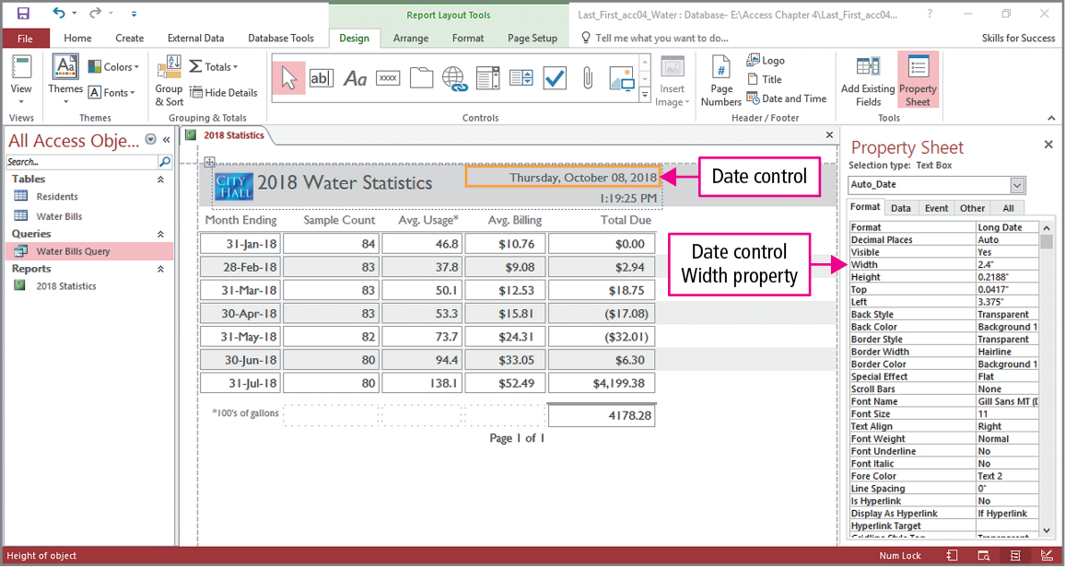
Skill 3: Format Reports
Notes:
There are two methods for formatting report controls: using a control’s property sheet or using the command on the Format tab.
Returning to Layout view, click Logo in the Header/Footer group on the Design tab to open the Insert Picture dialog box. In the Insert Picture dialog box, navigate to the location of the file and select it. Select a control, click Property Sheet in the Tools group on the Design tab, and in the property sheet Format tab, the control’s width can be changed. In the text example, the Title control’s width is changed to 2.6” and the Date control’s width is changed to 2.4”.

Slide 14
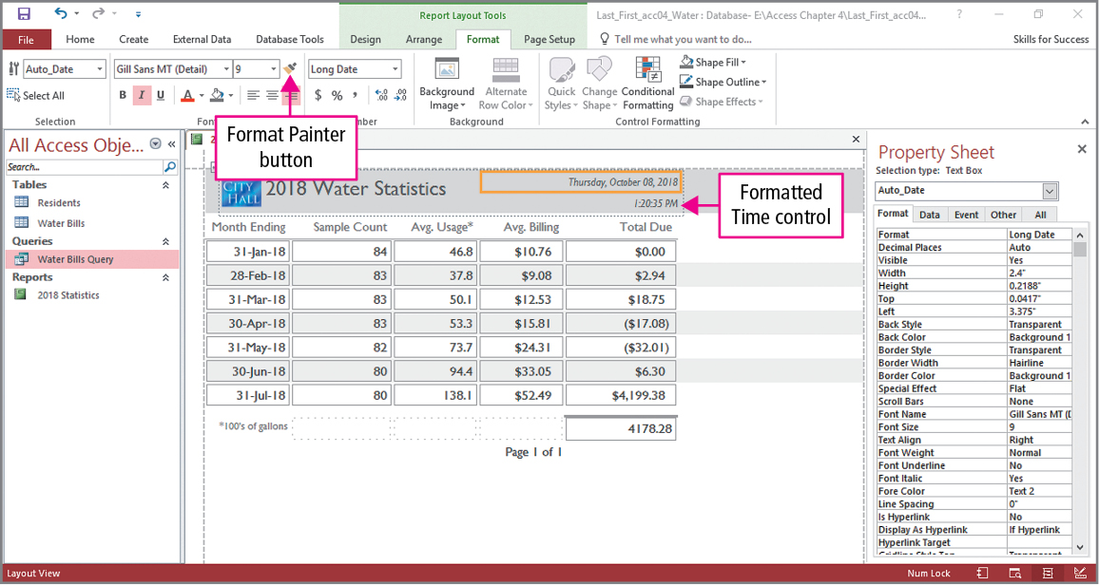
Skill 3: Format Reports (cont.)
Notes:
Still using the Date control property sheet, the font size and appearance can be changed. In the text example, the font size is change to 9 and italics have been applied to the text. The Format Painter located in the Font group is a tool that is used to quickly copy formatting from one object another. With the Date control still selected, click the Format Painter and click the Time control to apply the same formatting to Time control.

Slide 15
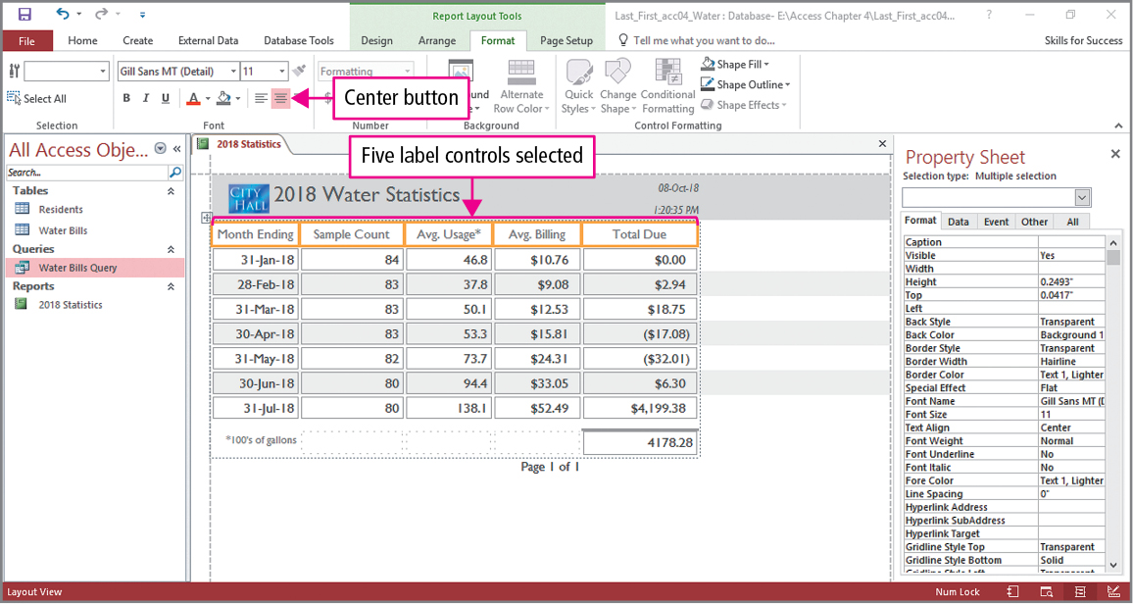
Skill 3: Format Reports (cont.)
Notes:
The date and time controls can be formatted by clicking the Number Format arrow in the Number group, and then selecting the desired format. The textbook example has the two controls changed to Medium Date and Medium Time number formats. The final change on this slide is to the column headings. By pressing and holding Shift while clicking, multiple objects can be selected, and any formatting changes will be applied to all selected objects. On this slide, the five heading label controls have been selected, and clicking the Center button in the Font group centers all five labels.

Slide 16
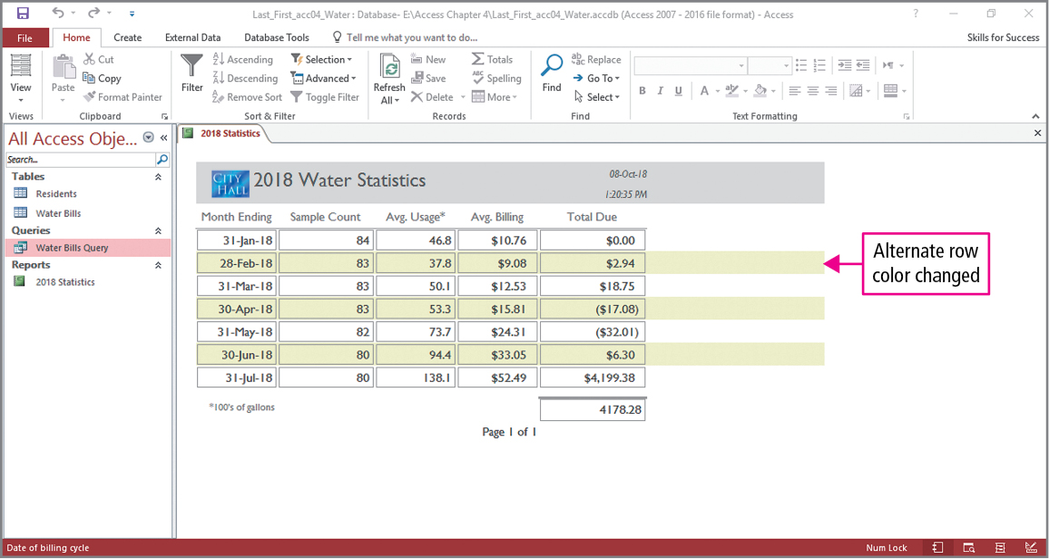
Skill 3: Format Reports (cont.)
Notes:
The final change will improve the report’s readability by adding alternate colors to the rows. To do this, click the Selection arrow in the Selection group on the Format tab and then click Detail. Once the selection is made, click the Alternate Row Color arrow in the Background group on the Format tab to display the color gallery, and select the desired color banding. The slide shows the selection of the Green, Accent 2, Lighter 80% color.

Slide 17
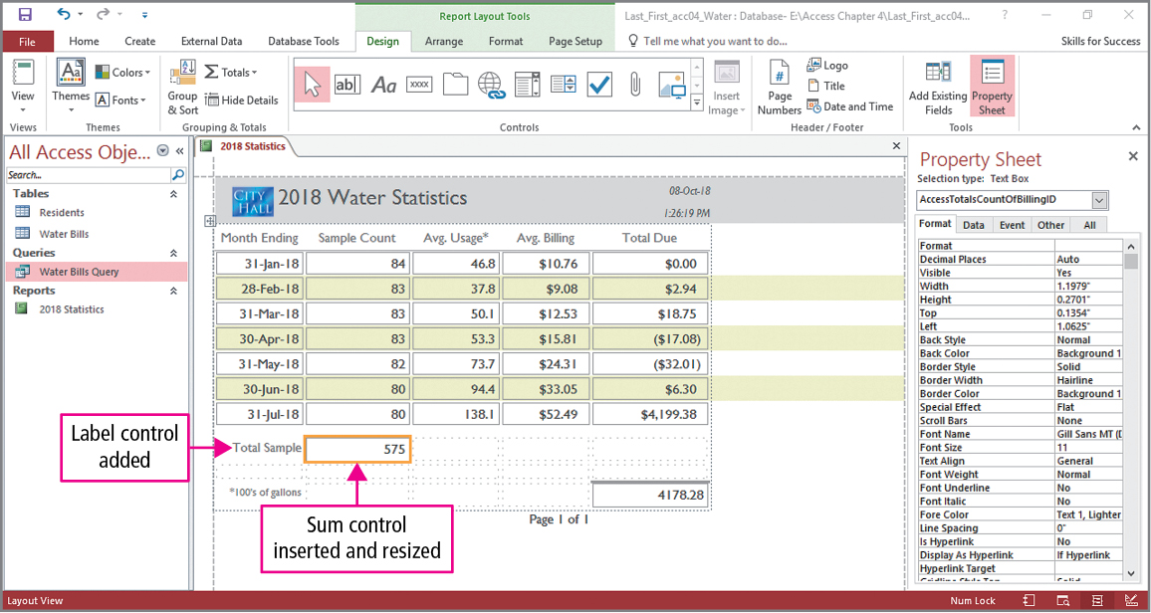
Skill 4: Add Totals to Reports
Notes:
Summary statistics such as totals, averages, and counts can be added to report columns. Using Layout view a new control will be added to the report. Click in the last row of the report, then click Insert Above in the Rows & Columns group on the Arrange tab two times. In the first new cell Total Sample will be added. Click any cell in the second column to select the column and click Totals in the Totals group on the Design tab and click Sum. Click the sum control and AutoSize its height.

Slide 18
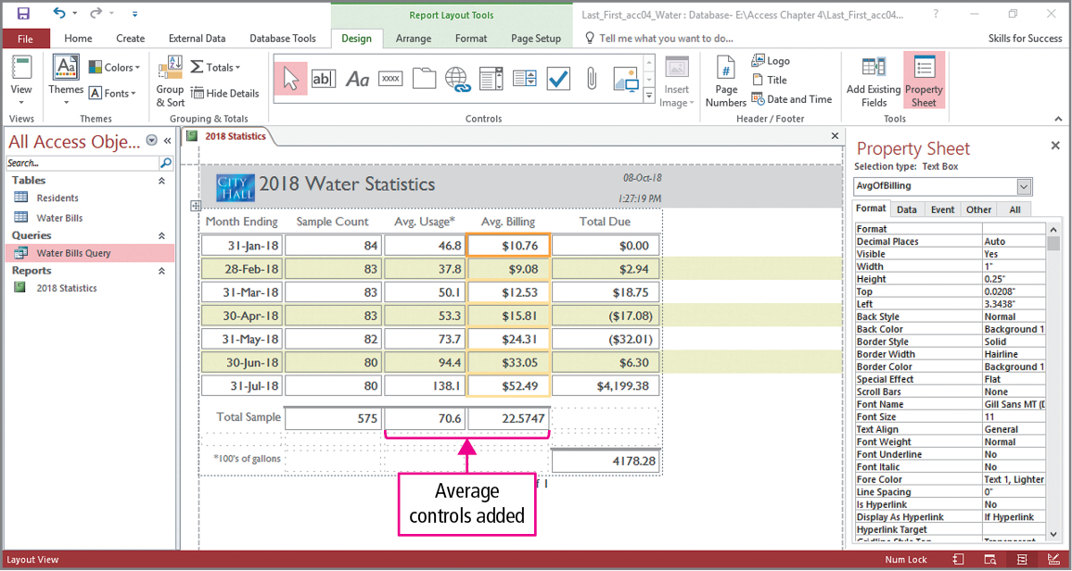
Skill 4: Add Totals to Reports (cont.)
Notes:
For the next two columns, repeat the process from the previous slide, but selecting Average instead of Sum.

Slide 19
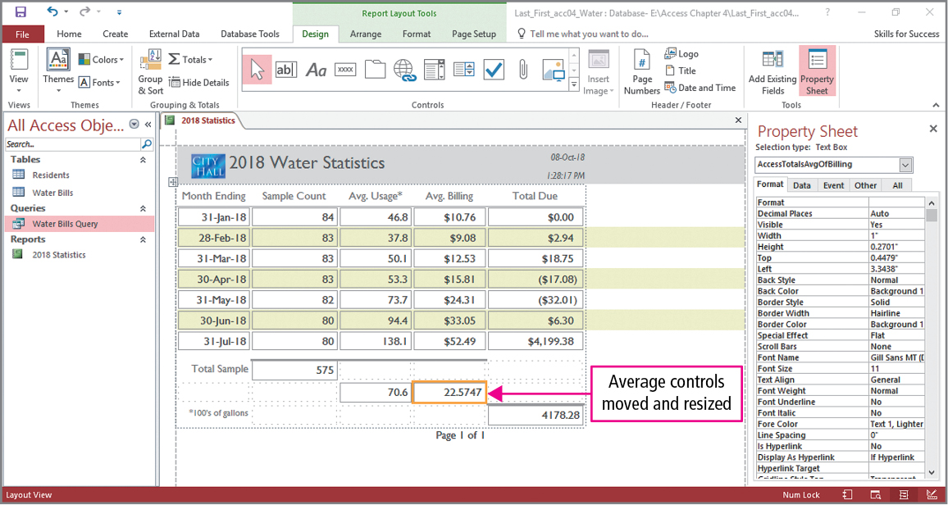
Skill 4: Add Totals to Reports (cont.)
Notes:
On this slide, some of the summary controls will be moved and resized. To move a control, point to its interior, and when the pointer becomes a four-headed arrow, drag it to the desired location. On this slide, both of the average controls have been moved and their heights adjusted using AutoSize.

Slide 20
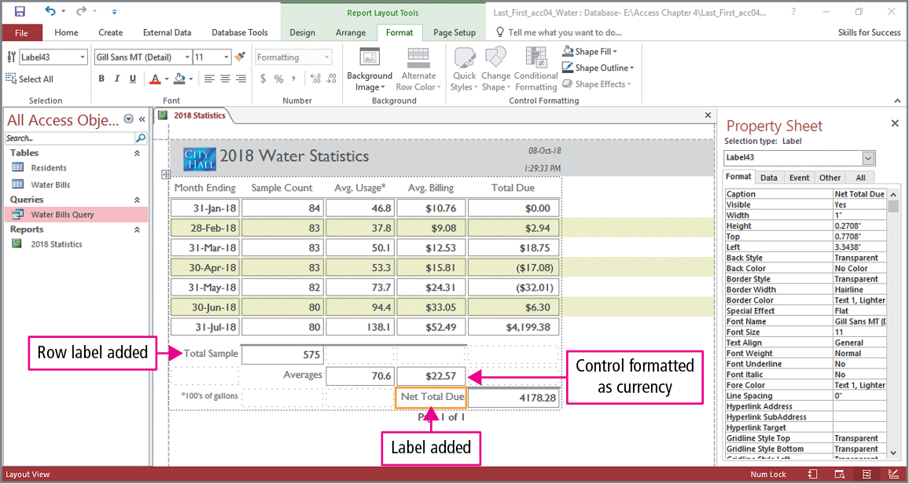
Skill 4: Add Totals to Reports (cont.)
Notes:
In the final slide, two labels will be added to the report, and a summary statistic will be formatted as Currency. We have already seen how to add labels, so we will focus on formatting the statistic. Select the Avg. Billing column Average control, and then click the Currency button in the Number group on the Format tab.

Slide 21
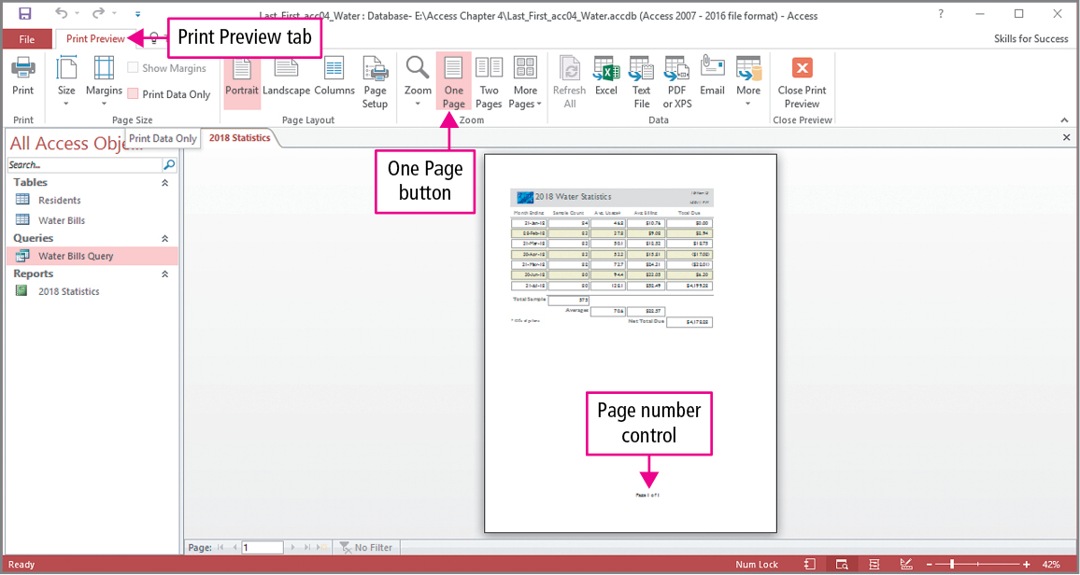
Skill 5: Preview and Print Reports
Notes:
Usually, a report is previewed before it is printed. Once a report has been previewed and any needed formatting adjustments have been made, it can be printed. To preview a report, click the View arrow in the Views group on the Home tab. Notice when in Print Preview view, the Print Preview tab is the only ribbon tab, and the report is displayed as it will when printed on paper, including pagination. As you can see, with only five fields the report is narrow enough to fit on a single page.
To exit print preview, click Close Print Preview in the Close Preview group.

Slide 22
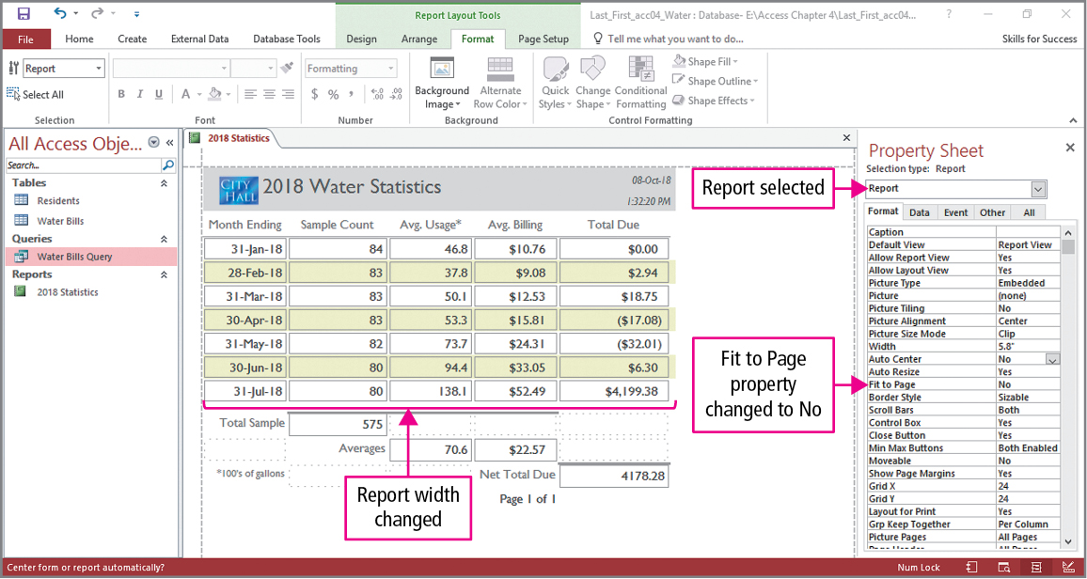
Skill 5: Preview and Print Reports (cont.)
Notes:
By default, a report is set to the width of a printed sheet of paper. By removing this setting, you can decrease the width of the report to fit the contents. We will now use Layout view to make some adjustments to the report. We begin by clicking the Selection arrow in the Selection group on the Format tab, and then clicking Report. With the report selected, open its Property Sheet. On the Format tab, double-click the Fit to Page box to change the value to No. Change the Width property to the desired value, which is 5.8 in the text. Before moving to the next slide, notice the border around the control in the lower right of the report that contains the value 4178.28.

Slide 23
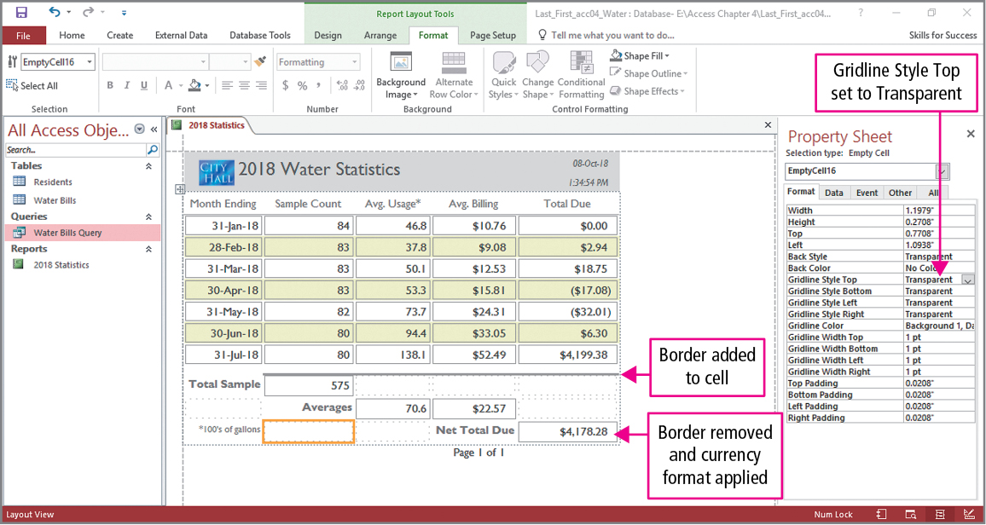
Skill 5: Preview and Print Reports (cont.)
Notes:
On this slide, some formatting changes are made. We have already seen how to change font attributes like bolding and alignment, how to use AutoSize to adjust heights or widths, how to apply number formatting, and how to use Format Painter to copy formatting from one control to others. However, we will look at a new change—the addition or deletion of gridlines or borders. To add a gridline or border to a cell, select the cell and in its property sheet on the Format tab, double-click Gridline Style Top, change its value to the desired style, double-click Gridline Width Top and change its value to the desired width. In the text, the cell below the table has a solid 2 pt gridline or border added to it. We have added a gridline or border, and now we will remove one. In this example we will remove the gridline or border surrounding the control with the value 4178.28. Select this control, and in its property sheet on the Format tab, click Gridline Style Top, click the arrow, and click Transparent.

Slide 24
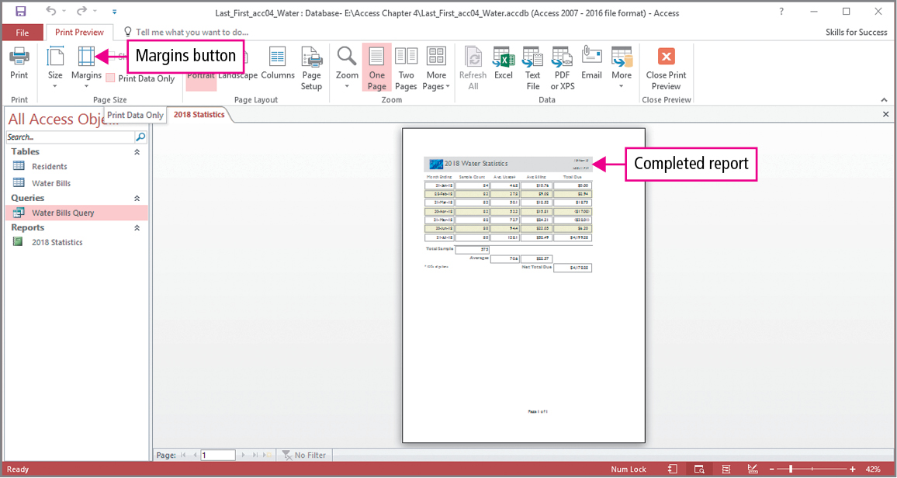
Skill 5: Preview and Print Reports (cont.)
Notes:
Click Print Preview, click Margins in the Page Size group, and click Wide.

Slide 25
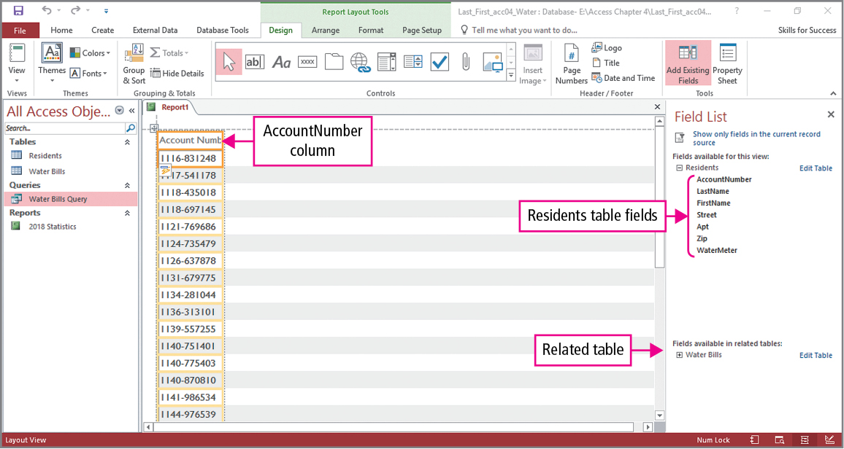
Skill 6: Create Reports with the Blank Report Tool
Notes:
The Blank Report tool is used to build a report by adding fields one at a time. Click Blank Report in the Reports group on the Create tab. In the Field List pane, click Show all tables so that all the tables are displayed. In the Field List, each table has an Expand button next to it, and clicking the button list the fields in the table. Double-click a field to add it to the report. As seen on the slide, the Account Number field from the Residents table has been added to the report.

Slide 26
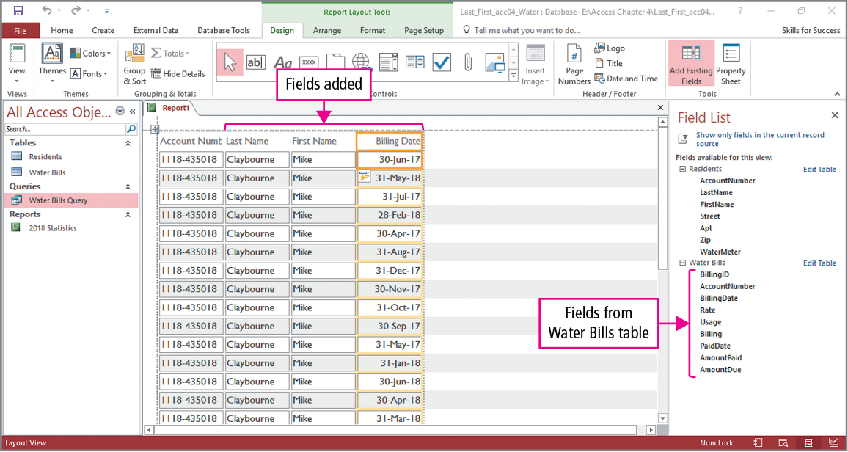
Skill 6: Create Reports with the Blank Report Tool (cont.)
Notes:
Additional fields are added using the same process. The slide shows the Last Name and First Name have been added from the Residents table and the Billing Date has been added from the Water Bills table.

Slide 27
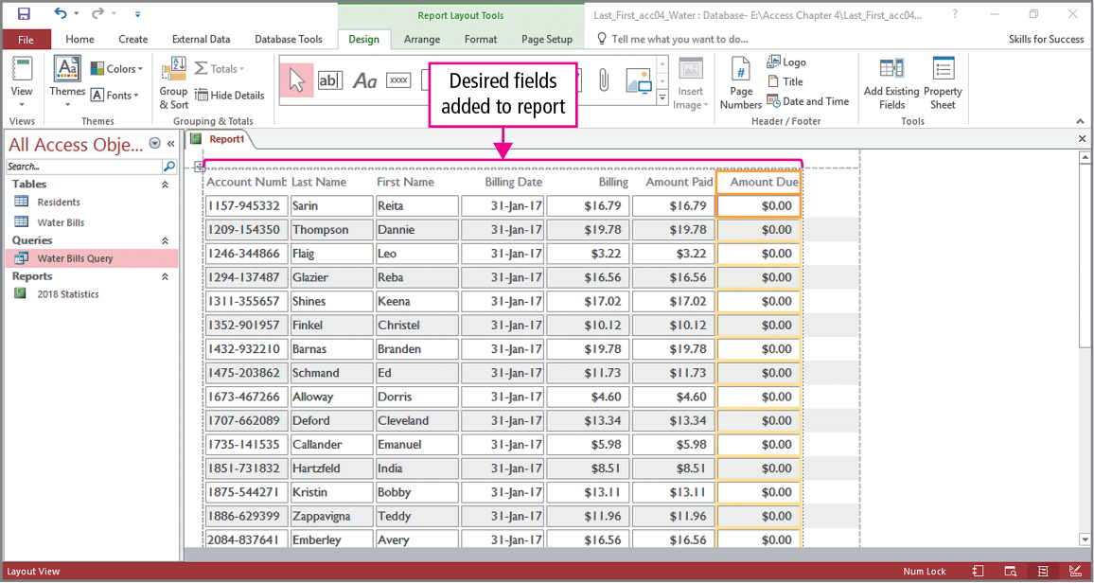
Skill 6: Create Reports with the Blank Report Tool (cont.)
Notes:
On this slide, three additional fields—Billing, AmountPaid, and AmountDue—have been added from the Water Bills table.

Slide 28
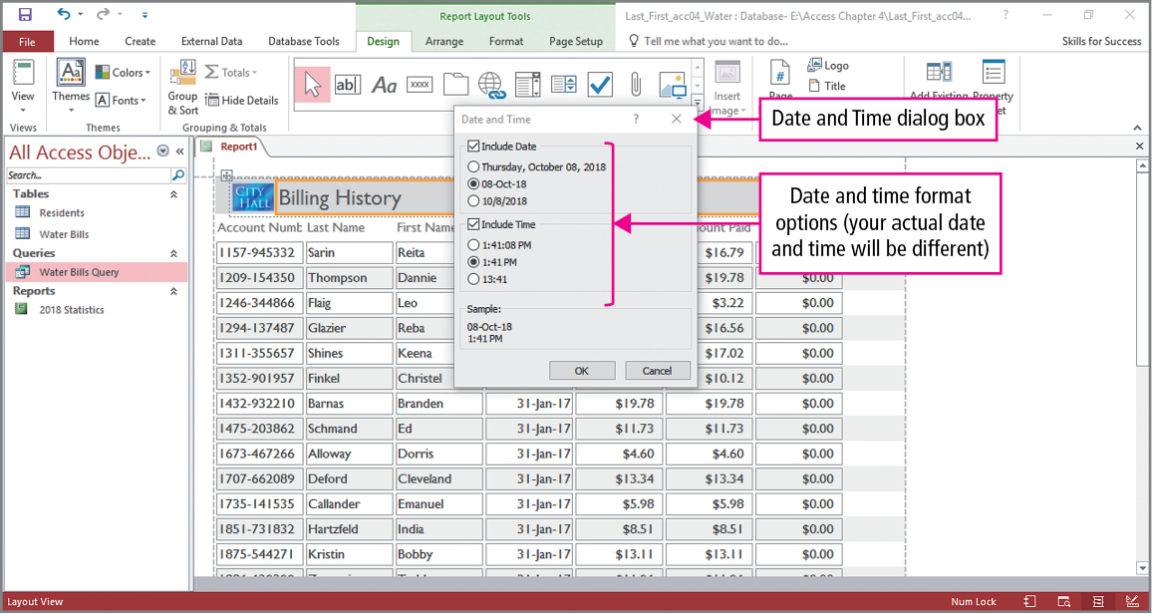
Skill 6: Create Reports with the Blank Report Tool (cont.)
Notes:
To complete this report, we add a logo and title, which we already know how to do, and add date and time controls. Click Date and Time in the Header/Footer group on the Design tab to display the Date and Time dialog box. In the dialog box, under Include Date, select the desired option and under Include Time, select the desired option. On the slide, we see that dd-mm-yy and hh:mm PM are chosen for the date and time.

Slide 29
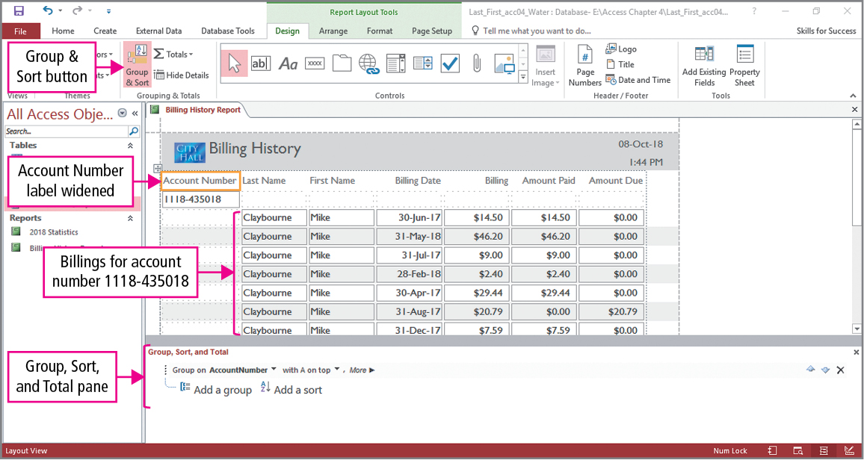
Skill 7: Group and Sort Reports
Notes:
You can group and sort report data to make the report information more useful. Grouping and sorting will be done from the Layout view. Click Group & Sort in the Grouping & Totals group on the Design tab to display the Group, Sort, and Total pane. In the pane, click Add a group, and from the list of fields, click the field on which grouping will be based. As shown on the slide, the report will be grouped on the AccountNumber field, and some formatting changes have been made to the report.

Slide 30
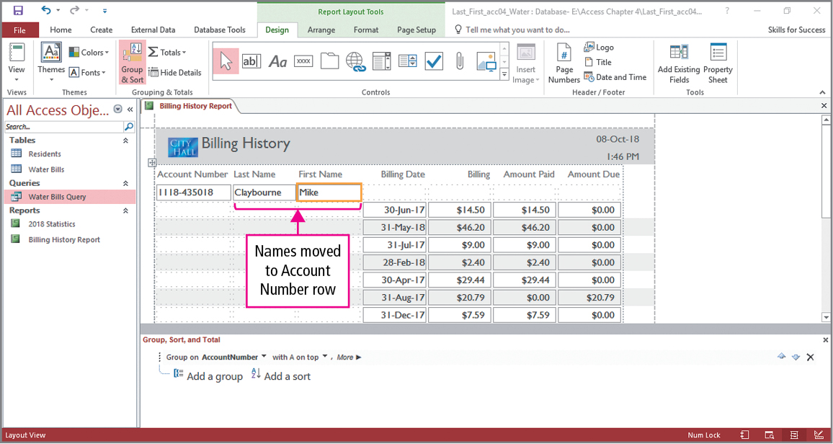
Skill 7: Group and Sort Reports (cont.)
Notes:
The two name fields are dragged to new locations. Since the resident names do not change within each group of account numbers, they are placed in the same row as the Account Number. In this way, the names appear only once.

Slide 31
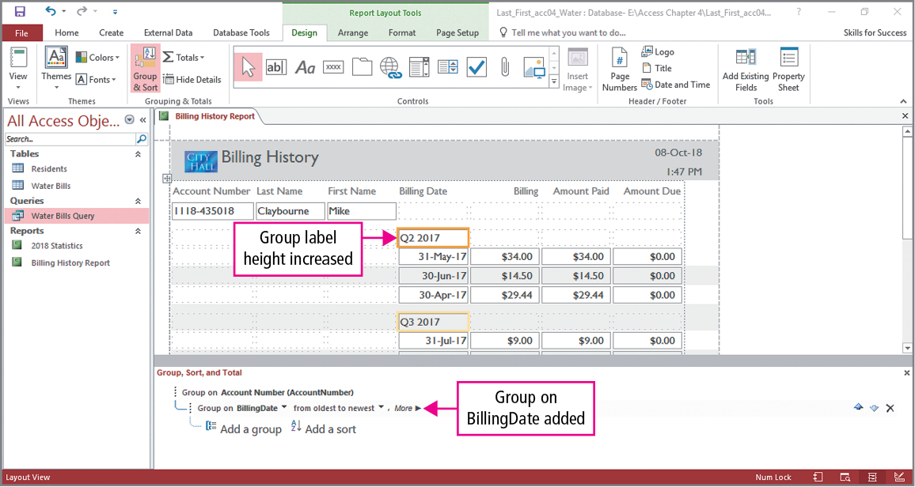
Skill 7: Group and Sort Reports (cont.)
Notes:
Repeat the grouping process and add a second group. In this example, the BillingDate field is added to the pane. This means that the fields will be first grouped by account numbers, and then within each account number, they will be grouped by the billing date. An additional field has had its height adjusted.

Slide 32
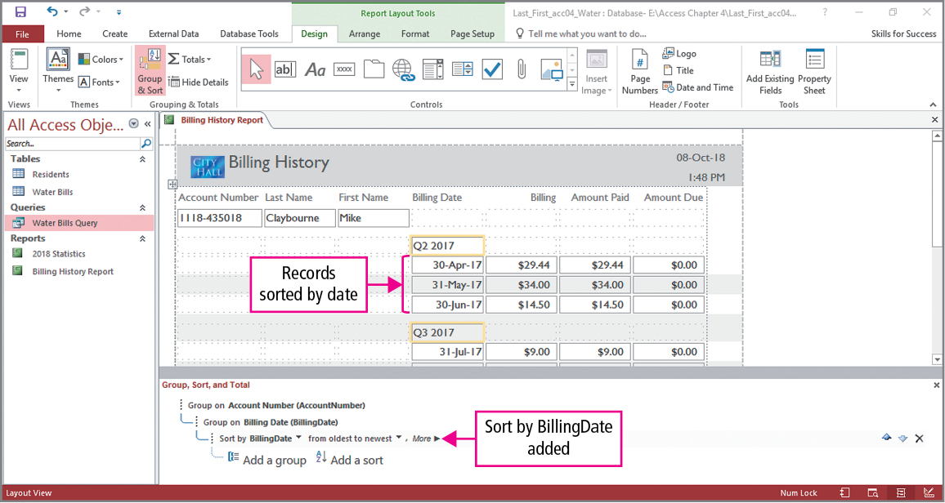
Skill 7: Group and Sort Reports (cont.)
Notes:
We now add a sort to the report. In a manner similar to grouping, display the pane at the bottom of the screen, but this time click the Add a sort button, and select the BillingDate field. Close the pane.

Slide 33
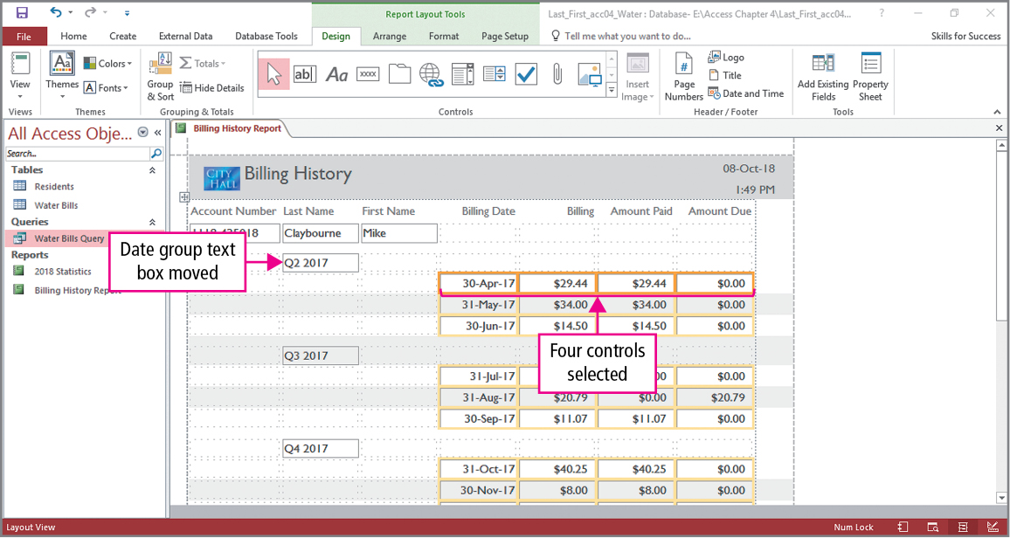
Skill 8: Modify Report Layouts
Notes:
In a tabular layout, rows and columns can be inserted and deleted and controls can be moved to more effectively communicate the report’s information. Using the dragging technique, a control can be selected and moved to a new location. Remember, to select multiple objects, press and hold the Shift key while clicking the objects. As shown on the slide, the data group has been moved and four controls have been selected.

Slide 34
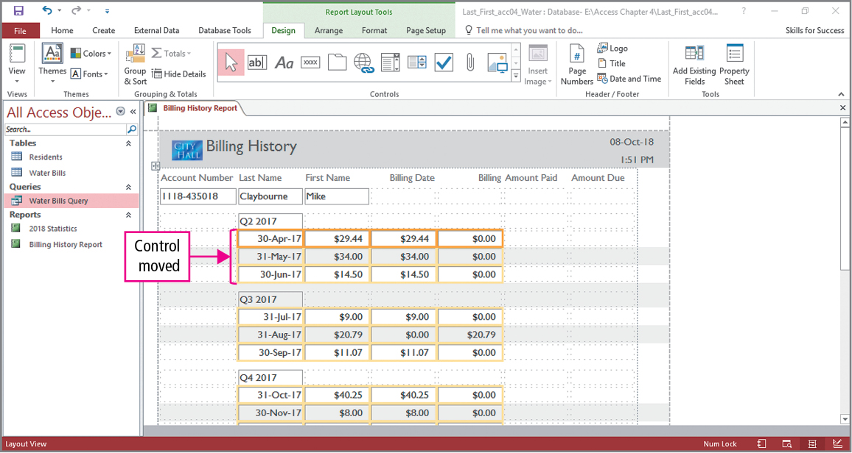
Skill 8: Modify Report Layouts (cont.)
Notes:
With the four cells selected, they are going to be moved fit under Date group text boxes as shown on the slide.

Slide 35
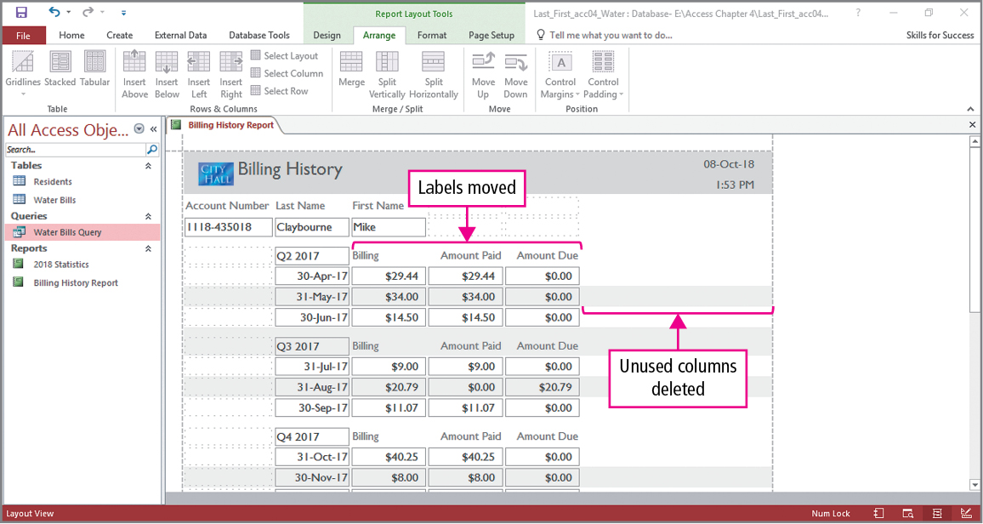
Skill 8: Modify Report Layouts (cont.)
Notes:
Additional changes will be made to the report. To remove a control, click it and press Delete. The slide shows the Billing Date label has been removed, and the Billing, Amount Paid, and Amount Due labels have been moved so they are now headings over their respective columns.

Slide 36
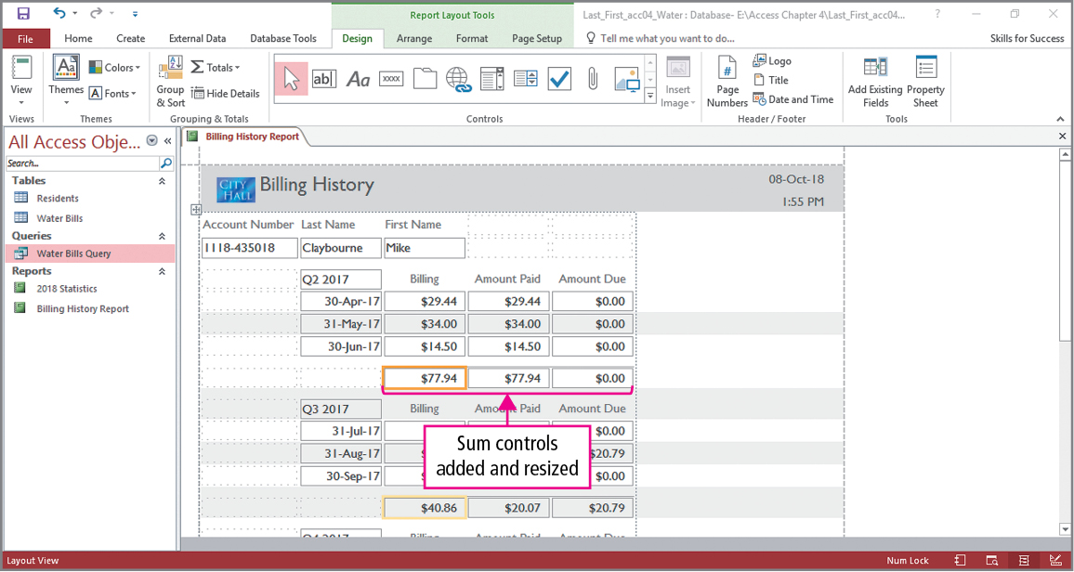
Skill 8: Modify Report Layouts (cont.)
Notes:
To remove an entire column, select it, click Select Column in the Rows & Columns group on the Arrange tab, and press Delete. Our final change will be the addition of summary controls. To add a summary control to a report, click in the column where the control will be added, click Totals in the Grouping & Totals group on the Design tab, and select the statistic. As shown on the slide, the two blank columns have been removed, and Sum controls have been added to the report. Additionally, some formatting has been done to selected controls.

Slide 37
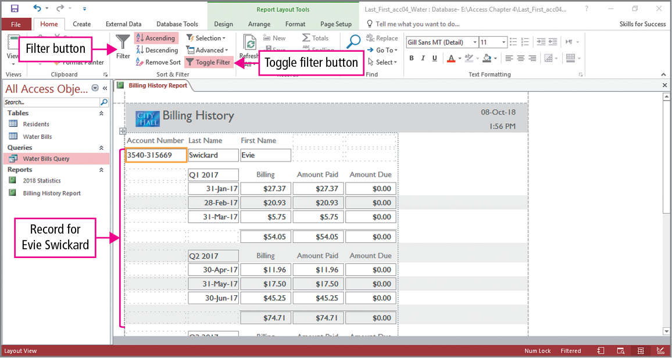
Skill 9: Filter Reports
Notes:
A report can be filtered so that only the desired information is seen. In this example, a filter will be applied so only records meeting certain criteria are shown. Specifically, only records for residents whose last name is Swickard will be displayed. Click in a last name text box, and click Filter in the Sort & Filter group on the Home tab. In the Filter list, point to Text Filters, and click Equals. In the Custom Filter dialog box, type swickard and click OK.
When you apply a filter, only the subset of records that match the filter criteria display. The Toggle Filter button is appropriate named, since each time it is clicked, the filter is turned on or off.

Slide 38
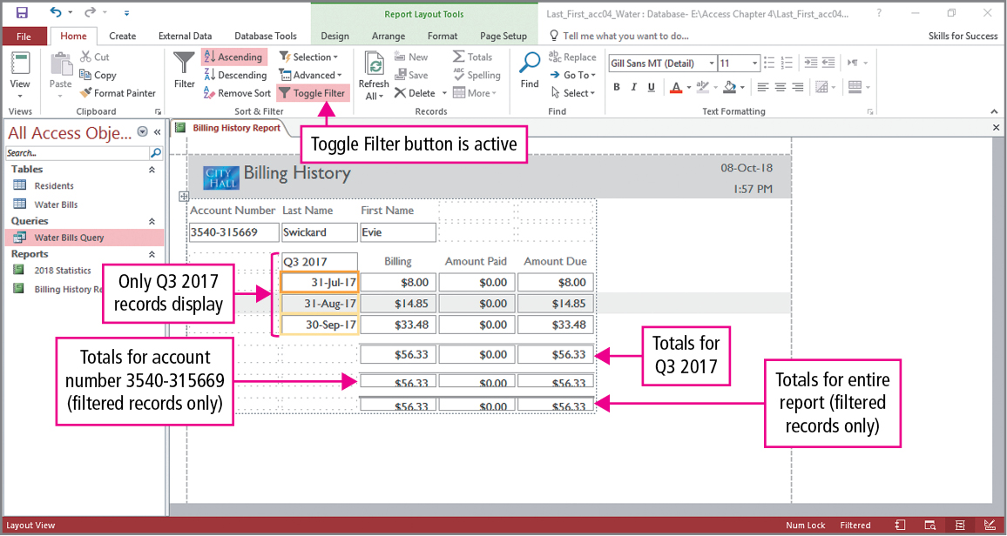
Skill 9: Filter Reports (cont.)
Notes:
The previous filter was based on equality, that is, finding a specific name. In the next filter, we will filter a report based on a range of dates. Click Filter in the Sort & Filter group on the Home tab. In the Filter list, point to Date Filters and click Between, to open the Between Dates dialog box. The dialog box has two boxes—Oldest and Newest. The example in the text shows a filter report that displays third-quarter results. This was done by typing 7/1/17 in the Oldest box and 9/30/17 in the Newest box. Notice the previous filter is still in effect so only the third-quarter bill for Swickard is displayed in the report.

Slide 39
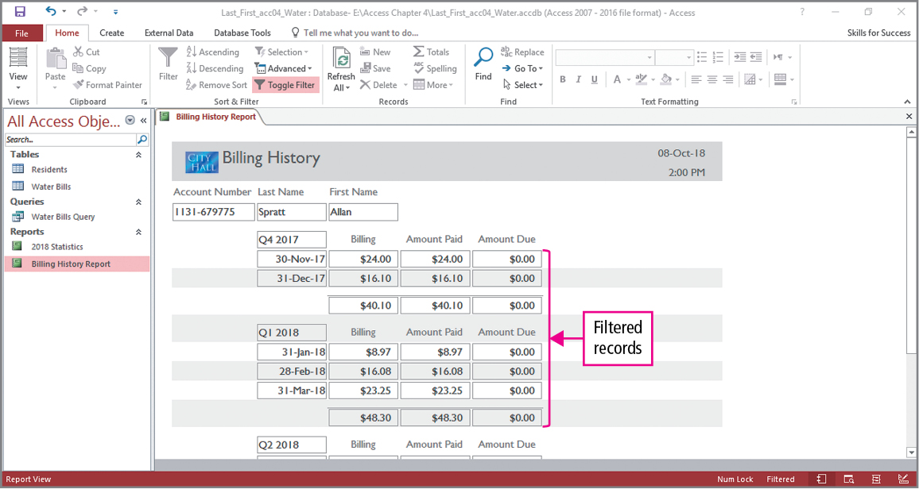
Skill 9: Filter Reports (cont.)
Notes:
When closing and reopening a report, the filters are not active. The Toggle Filter button must be clicked to activate them. To remove filters, you click Clear All Filters in the Sort & Filter group on the Home tab. To display records of another resident, repeat the process used for Swickard. The slide shows the results of filtering records using the name Spratt.

Slide 40
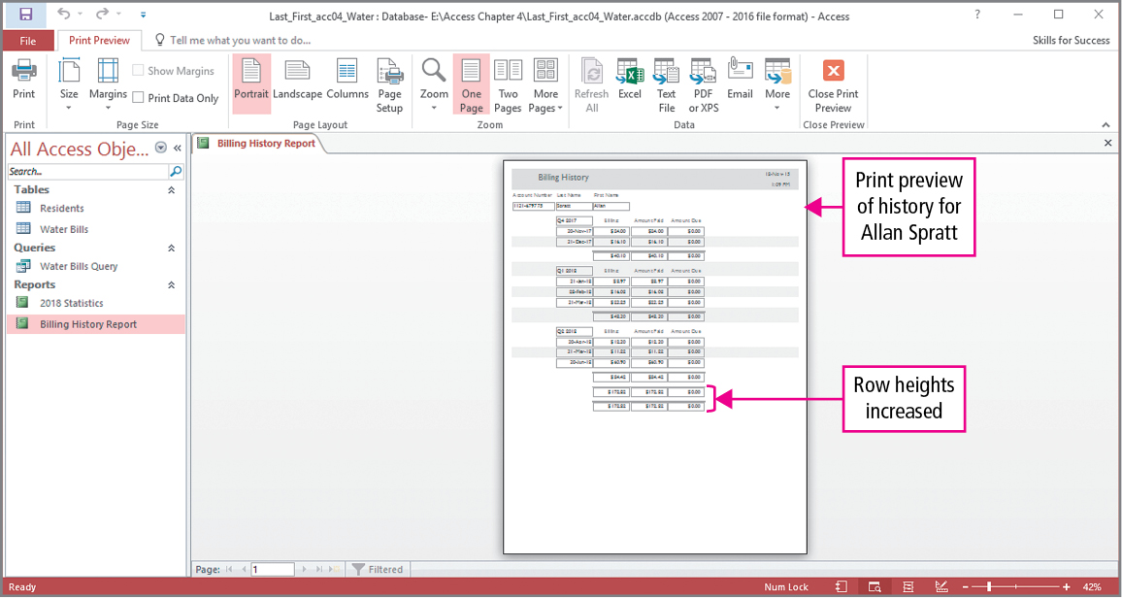
Skill 9: Filter Reports (cont.)
Notes:
In the final slide, the row heights of selected controls have been resized, and the view has been changed to Print Preview. Clicking the One Page button shows that the report will print on a single sheet of paper.

Slide 41
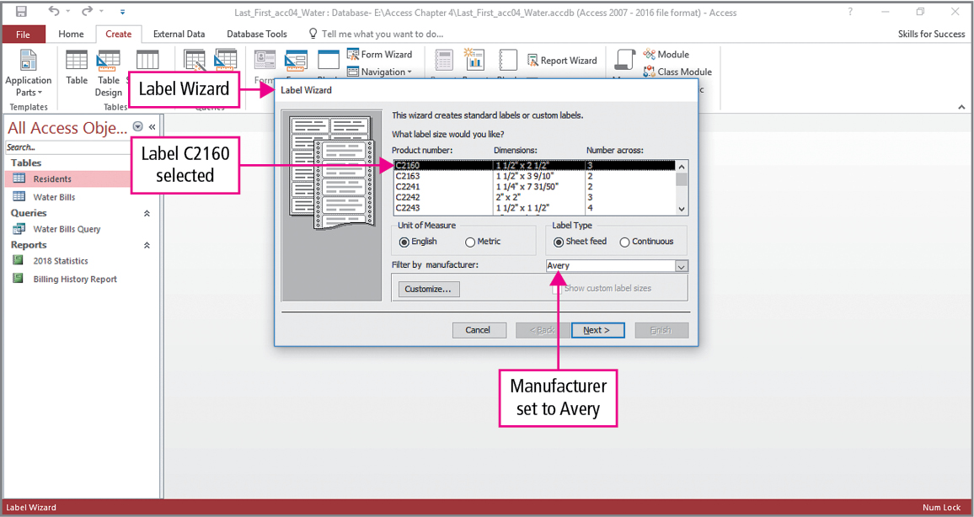
Skill 10: Create Label Reports
Notes:
As its name implies, a label report is a report formatted to print on a sheet of labels. Label manufacturers identify their label sheets using a product number, and Access formats the report to match the dimensions of the
selected sheet size. Since a label report is a report, the Labels button is in the Report group on the Create tab. Clicking this button opens the Label Wizard, in which the correct label is selected. As shown on the slide, Avery C2160 labels are used.

Slide 42
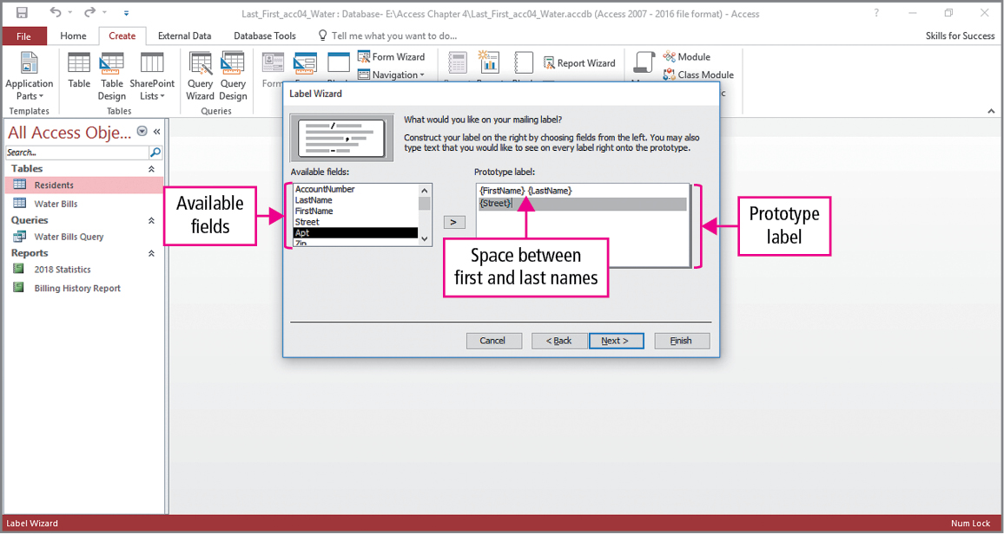
Skill 10: Create Label Reports (cont.)
Notes:
In the next step, the font and font size can be changed. On the slide, the familiar Available fields box is shown from which fields are moved to the Prototype label box. In addition to moving selected fields, the keyboard is also used. For example, a space is needed between the first and last names, and the address is printed on the next line.

Slide 43
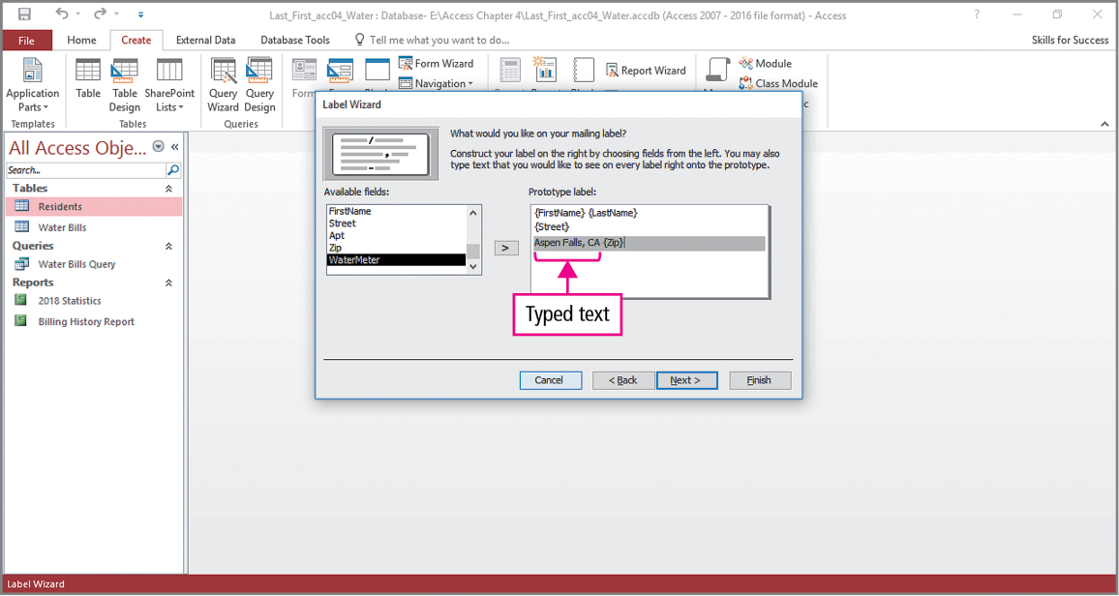
Skill 10: Create Label Reports (cont.)
Notes:
Since the labels are used for residents of the same city, the city name and state, Aspen Falls, CA in this example, is typed. Finally a space is added and the Zip field is move to the form. The wizard is completed by clicking Next two times and naming the report. The finished report is shown on the next slide.

Slide 44
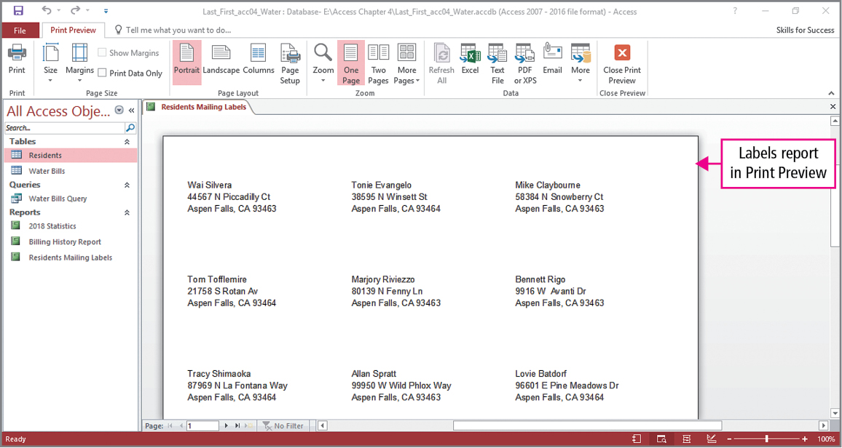
Skill 10: Create Label Reports (cont.)
Notes:
Recall that it is a good practice to preview reports before printing them. This slide shows the label report as viewed in Print Preview.

Slide 45
More Skills For Success
You will now practice the following additional skills:
Change Report Sort Order and Orientation
Export Reports to Word
Save Reports as PDF Documents
Save Reports as Web Pages
Notes:
You will now practice the following additional skills:
Change Report Sort Order and Orientation
Export Reports to Word
Save Reports as PDF Documents
Save Reports as Web Pages

Slide 46
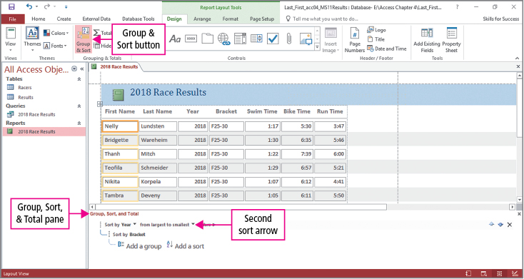
More Skills 11: Change Report Sort Order and Orientation
Notes:
You can change the sort order of a report to present information in a more meaningful manner. To change the sort order, click the Group & Sort button on the Design tab.
Reports can be set to landscape or portrait orientation to allow the content to fit within the report page margins. Orientation can be changed in the Page Layout group in the Print Preview view of a report.

Slide 47
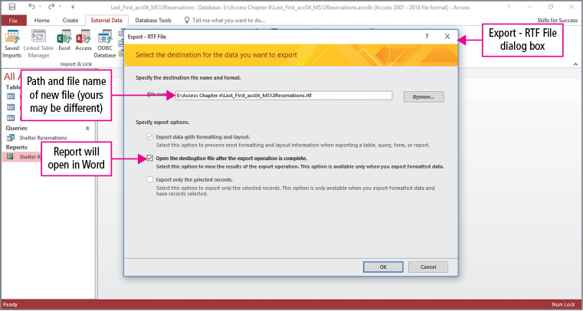
More Skills 12: Export Reports to Word
Notes:
Besides importing database object from another database, reports can be exported to other file formats. When exporting a report to Word, the report is saved as a Rich Text Format file, which is a document in a file format that works with many different types of programs.
To export the report, click Word in the Export group on the External Data tab to open the Export – RTF File dialog box.

Slide 48
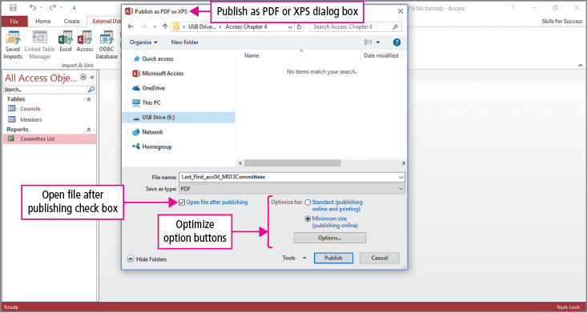
More Skills 13: Save Reports as PDF Documents
Notes:
In addition to exporting reports using the RTF file format, another frequently used file format is PDF. A Portable Document Format file is a file format that preserves document layout and formatting, and these files can be viewed in a variety of applications. To export this report, click PDF or XPS in the Export group on the External Data form to open the Publish as PDF or XPS dialog box.

Slide 49
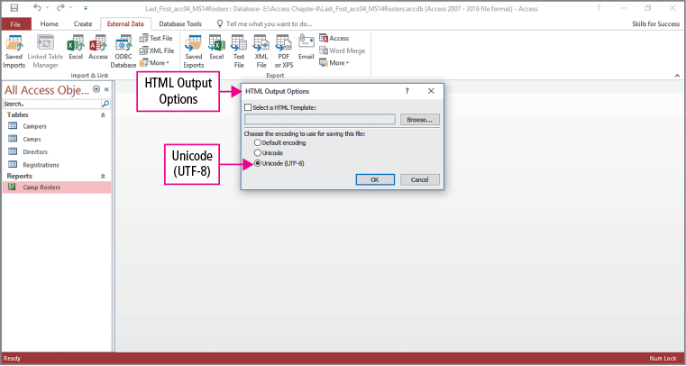
More Skills 14: Save Reports as Web Pages
Notes:
Our final export example will save a report as a web page in HTML format. A Hypertext Markup Language document is a text file that includes instructions for displaying its content in a web browser.
To export this report, click More in the Export group on the External Data form, and then click HTML Document to open the Export - HTML Document dialog box.

Slide 50
Summary
Reports
Grouping, sorting, and filtering
Label reports
Exporting reports
Notes:
Reports are designed to present information originated from tables and queries. The records in a report can be grouped, sorted, and filtered to make the information more valuable. Reports can be built using fields from an entire table or fields selected from a query.
Label reports are used to print labels.
Reports can be exported in a variety of formats.

Slide 51
Questions
Notes:
As you complete this introduction to Access, be sure you ask questions. You want to understand the concepts so that you can continue to build on them in future chapters.

Slide 52

Copyright
All rights reserved. No part of this publication may be reproduced, stored in a retrieval system, or transmitted, in any form or by any means, electronic, mechanical, photocopying, recording, or otherwise, without the prior written permission of the publisher. Printed in the United States of America.

